Slide 1


U.S. General Services Administration
The Financial Management Information System
VAT DATA COLLECTION PROCESS
QUICK REFERENCE CARD
This Quick Reference Card is designed to provide users of FMIS with an understanding of the Valid Accounting Transaction (VAT) data collection process and data update frequencies.
KEY TAKE-AWAYS: To understand how VAT data is collected, how it is formatted in FMIS, and know when refreshed data will be available
Last Updated: March 2011
FMIS RESOURCES
FMIS User Guide
FMIS Quick Reference Cards:
System Access and Log-In
Saving and Printing Data
VAT Data Collection Process
Queries
Frequently Used Queries
For additional support with FMIS, please contact the OCFO Service Desk at ocfoservicedesk@gsa.gov

Slide 2
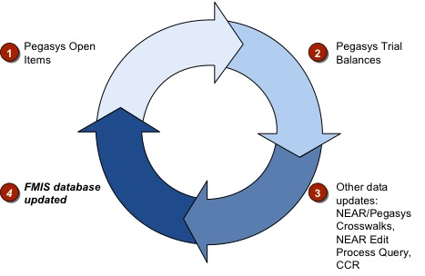
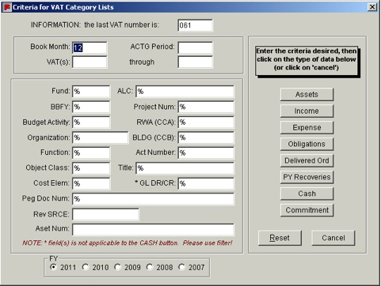
VAT AND PEGASYS DATA BACKGROUND
VAT data is made up of detailed Pegasys Journal Entries for each fiscal year through FY11.
Since October 2002 Pegasys has been the system of record for all transactional data. Transactional data from fiscal years 2007-2011 is available through FMIS (current fiscal year plus four prior fiscal years). if prior years’ data are required, please contact the OCFO Service Desk.
VAT DATA
MIS houses VAT data in a consistent format and data structure:
Numbered by 3 position Julian date from which transactions originated (weekend data are combined into Sunday’s date)
Category Lists – Pre-filtered by major SGL functional category
Assets – 14, 15, 16, 17, 18, 19
Income – 5610
Expense – 6
Obligations – 4801, 4802, 4899, 4901, 4902, 4881, 4882, 4981, 4982
Delivered Orders – 4901, 4902
Prior-year Recoveries – 4871, 4872, 4971, 4972
Deferred Income – 2320.01, 2310.04, 2310.01
Unfilled Customer Orders – 4221, 4222
The accompanying screenshot illustrates these criteria available for VAT Category List queries:
Keep in mind that FMIS will display the Pegasys data format. For example, Budget Activity will have four positions, Function Code will have five positions, General Ledgers will have up to seven positions, and so forth.
MISCELLANEOUS DATA
Other Pegasys data available via FMIS include:
Pegasys Open Items – Daily cycle updated open obligations balances
Pegasys Trial Balances – Detailed trial balance from GL summary tables
NEAR/Pegasys Crosswalks
NEAR Edit Process Query
VAT DATA REFRESH AND UPDATE CYCLE
FMIS’ VAT data is pulled from Pegasys each day, Monday–Saturday at 05:00 GMT. Data is extracted from Pegasys’ Accounting, Transaction, General Ledger and Fixed Assets journals.
Open Items and Trial Balance data are pulled from Pegasys and refreshed at midnight EST.
Important: FMIS VAT data is updated daily at 05:00 GMT, and not in real time. Therefore, a current day’s VAT data is not available until the next day.
Important: Each VAT is identifiable by a specific VAT number, which corresponds to the three-position Julian date from which the transaction originated. All weekend data is combined into Sunday’s date. For example, a transaction that contains VAT number 108 in FY 2011 corresponds to data from April 18th, 2011. VAT number 114 in FY 2011 corresponds to data from the weekend of April 23-24th, 2011.
Figure 2: FMIS Update Schedule
Figure 1: VAT Category Lists

